Slide 1
Object-Oriented Programming and Data Abstraction Lesson 9: Exceptions
Notes:
Replace this with your course title and your name/contact details.

Slide 2
Defensive Programming

Slide 3
Defensive Programming
The programmer attempts to handle all possible error states.
Murphy's Law: "Anything that can go wrong, will go wrong."
"The whole point of defensive programming is guarding against errors you don’t expect." -- Steve McConnell, Code Complete
Do you agree with this philosophy?
“…many code bases are dominated by error handling”
-- Michael Feathers, Clean Code

Slide 4
Three Approaches
Three Approaches
Assume that client objects will know what they are doing and will request services only in a sensible and well- defined way.
Assume that server objects will operate in an essentially problematic environment in which all possible steps must be taken to prevent client objects from using them incorrectly.
Assume an intentionally hostile client who is trying to break or find a weakness in the server.
Issues to Address
In practice,
Most client requests are reasonable
Occasionally client might issue an invalid call to a server
Design issues:
How much checking server should do on all method calls?
How to report errors?
How can a client anticipate failure?
How should a client deal with failure?

Slide 5
Boundaries on 100% Defensive Programming
Protect your code from invalid data coming from “outside”, wherever you decide “outside” is.
Data from an external system or the user or a file, or any data from outside of the module/component.
Establish “barricades” or “safe zones” or “trust boundaries” – everything outside of the boundary is dangerous, everything inside of the boundary is safe.
In the barricade code, validate all input data: check all input parameters for the correct type, length, and range of values. Double check for limits and bounds.
After you have checked for bad data, decide how to handle it.
Robustness / Correctness trade-off
Robust code: Do we keep running if there is a problem you can deal with?
Correct code: Never return inaccurate results.

Slide 6
Bad Data Strategy: The Exam
Bad data strategy:
Return an error and stop right away (fast fail),
Return a neutral value,
Substitute data values.
Example 1
public class Exam {
private int examNumber;
private double grade;
final static int MAX_GRADE = 100;
final static int MIN_GRADE = 0;
// Setter
public void setGrade(double grade) {
if (grade >= MIN_GRADE && grade <= MAX_GRADE) {
this.grade = grade;
}
else {
// Do what?
}
}

Slide 7
Bad Data Strategy: The Thermostat
Bad data strategy:
Return an error and stop right away (fast fail),
Return a neutral value,
Substitute data values.
Example 2
public class Thermostat {
private int currentTempSetting;
final static int MAX_TEMPERATURE = 90;
final static int MIN_TEMPERATURE = 40;
// Setter
public void setCurrentTempSetting( int temp) {
if (temp >= MIN_TEMPERATURE && temp <= MAX_TEMPERATURE) {
this.currentTempSetting = temp;
}
else {
// Do what?
}
}
}

Slide 8
The Car Brake
public class CarBrake {
private int currentTempSetting;
final static double MIN_DEPRESSION = 1.0;
final static double MAX_DEPRESSION = 20.0;
final static double ANTI_LOCK_THRESHHOLD = 12.0;
public void apply (double pedalDepression) {
if (pedalDepression >= ANTI_LOCK_THRESHHOLD && pedalDepression <= MAX_DEPRESSION) {
brake(pedalDepression);
engageAntiLock();
}
else if (pedalDepression >= MIN_DEPRESSION && pedalDepression < ANTI_LOCK_THRESHHOLD) {
brake(pedalDepression);
}
else if (pedalDepression < MIN_DEPRESSION) {
// Do what?
}
else {
// Do what?
}
}
Bad data strategy:
Return an error and stop right away (fast fail),
Return a neutral value,
Substitute data values.
Example 3

Slide 9
Other Defensive Approaches
Add diagnostic code, logging and tracing intelligently to help explain what’s going on at run-time, especially if you run into a problem.
Standardize error handling. Decide how to handle “normal errors” or “expected errors” and warnings, and do all of this consistently.
Use exception handling only when you need to, and make sure that you understand the language’s exception handler inside out.

Slide 10
Some causes of error situations
Incorrect implementation.
Does not meet the specification.
Inappropriate object request.
e.g., invalid index – index out of bounds
Inconsistent or inappropriate object state.
Object is being used in a way not anticipated by the designer
Developer has to look beyond the current application to see the object as an entire concept, independent of any one application.
Don't define a method or property in the public interface unless you are prepared to live with it forever.

Slide 11
Not always programmer error
Errors often arise from the environment:
Incorrect URL entered.
Network interruption.
File processing is particular error-prone:
Missing files.
Lack of space on disk
Lack of appropriate permissions.

Slide 12
Argument values
Arguments represent a major ‘vulnerability’ for a server object
Constructor arguments initialize state.
Method arguments often contribute to behavior
e.g., mutator methods
Argument checking is one defensive measure
Server should know if it should trust provided argument values
i.e., validate all arguments
Private methods could be an exception
Method’s pre- and post- conditions

Slide 13
Reporting Errors

Slide 14
Notifying the User
Techniques to notify a user of an error
System.out.println()
JOptionPane.showMessageDialog(null, "An error has occurred…", "Error", JOptionPane.ERROR_MESSAGE);
Use an invisible JLabel on a GUI; set its text and visibility.
Problems with these approaches
It assumes a human user. Many applications run independently of human monitors.
Users might not be able to address the error. Only in cases where the user’s direct action has led to the problem is the user likely to be able take some appropriate corrective or avoiding action.

Slide 15
Notifying the client object: Server error reporting
How to report illegal arguments to the client object?
Return a diagnostic value
Return false or other flag value when operation failed
Return null indicating that the requested Object does not exist
May not work if any returned value is acceptable
Client is not required to check for invalid return value
Difficult to differentiate between operation failure or invalid request (bad argument values)
Throw an exception
More robust Java feature with special syntax
Addresses some of the above issues

Slide 16
Returning a diagnostic (1)
Change method from void to boolean
public boolean removeDetails(String key)
{
if(keyInUse(key)) {
ContactDetails details = book.get(key);
book.remove(details.getName());
book.remove(details.getPhone());
numberOfEntries--;
return true;
}
else {
return false;
}
}

Slide 17
Returning a diagnostic (2)
public ContactDetails getDetails(String key) {
return book.get(key);
}
This method returns a ContactDetails object.
It could return null (might be confusing for client)
It could return an empty ContactDetails object
What if a method returned an integer key?
"Special" return codes e.g., Integer.MIN_VALUE, could signal an error
But the client needs to remember to check for those values.
Dangerous!

Slide 18
Returning null
One way for the getDetails method to indicate that the key is invalid or not in use is to have it return a null value instead of a ContactDetails object.
/** * Look up a name or phone number and return the * corresponding contact details. * @ param key The name or number to be looked up. * @ return The details corresponding to the key, or * null if the key is not in use. */ public ContactDetails getDetails(String key) { if (keyInUse(key)) { return book.get(key); } else { return null; } }

Slide 19
What can the client do?
Test the return value.
Attempt recovery on error.
Avoid program failure.
Ignore the return value.
Cannot be prevented.
Likely to lead to program failure.
Exceptions are preferable.

Slide 20
How do Exceptions work?

Slide 21
Exceptions
When something unexpected happens in a Java program, an exception is thrown.
The method that is executing when the exception is thrown must either handle the exception or pass it up the line.
To pass it up the line, the method needs a throws clause in the method header.
To insert a throws clause in a method header, simply add the word throws and the name of the expected exception.
PrintWriter objects can throw an IOException, so we write the throws clause like this:
public static void main(String[] args) throws IOException

Slide 22
Throwing an exception
Exceptions are objects representing details of program failure
An exception object is constructed:
new ExceptionType("...")
The exception object is thrown:
throw ...
Javadoc documentation:
@throws ExceptionType reason

Slide 23
The Throwable Hierarchy
It is recommended to list only checked exceptions in the throws clause
Checked at compile time: must be handled (try…catch) or "punted" with throws.
An Error indicates serious problems that a reasonable application should not try to catch.
You only need to include a throws clause on a method if the method throws a checked exception. If the method throws a runtime exception then there is no need to do so.

Slide 24
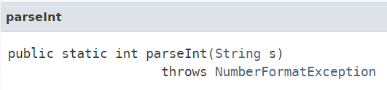
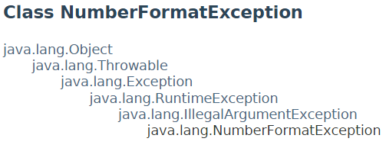
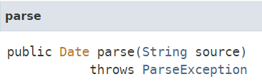
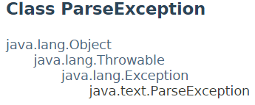
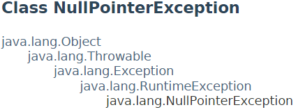
The Throwable Hierarchy
from Integer class
It is recommended to list only checked exceptions in the throws clause
from DateFormat class
You only need to include a throws clause on a method if the method throws a checked exception. If the method throws a runtime exception then there is no need to do so.

Slide 25
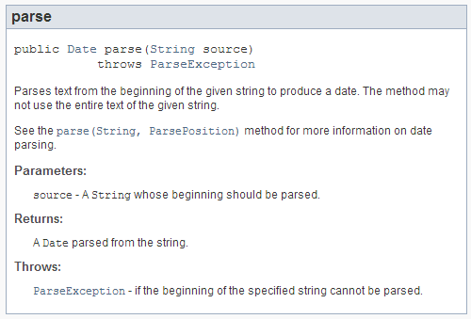
Some API Methods flagged as throwing CheckedExceptions
static private Date getBirthdate() throws ParseException {
Scanner sc = new Scanner(System.in);
System.out.println("Enter your birthdate (format like '11/25/1995'): ");
String birthdateString = sc.nextLine();
SimpleDateFormat sdf = new SimpleDateFormat("MM/dd/yyyy");
sc.close();
return
sdf.parse(birthdateString);
}

Slide 26
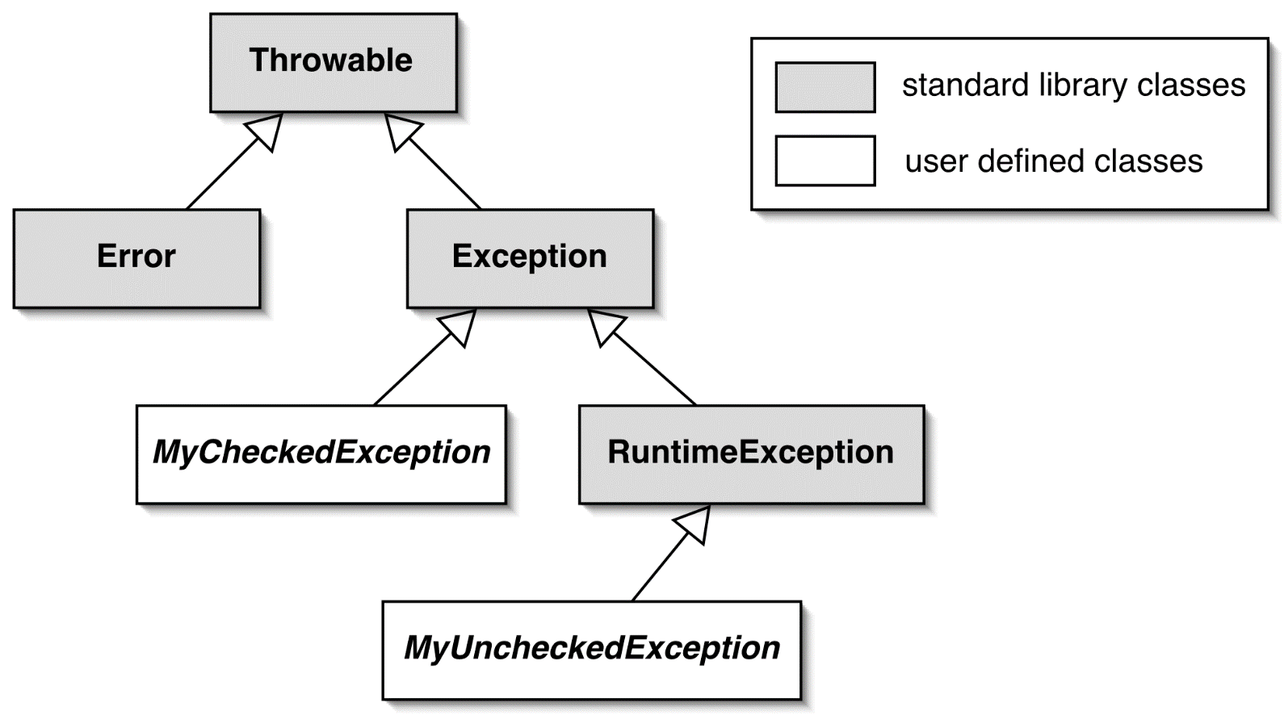
The exception class hierarchy
Defined in java.lang package
Can create new custom exceptions by extending standard exception classes (more on this later)

Slide 27
How to throw exceptions

Slide 28
Throwing an exception
/**
* Look up a name or phone number and return the
* corresponding contact details.
* @param key The name or number to be looked up.
* @return The details corresponding to the key,
* or null if there are none matching.
* @throws NullPointerException if the key is null.
*/
public ContactDetails getDetails(String key)
{
if (key == null) {
throw new NullPointerException(
"null key in getDetails");
}
return book.get(key);
}
What if someone called this method and passed in null?
That is, getDetails(null)
We are guaranteed that we will not pass null to the get() method.
Notes:
The method comment is included to illustrate the @throws javadoc documentation.

Slide 29
Argument checking
public ContactDetails getDetails(String key)
{
if (key == null) {
throw new NullPointerException(
"null key in getDetails");
}
if (key.trim().length() == 0) {
throw new IllegalArgumentException(
"Empty key passed to getDetails");
}
return book.get(key);
}
Now we are catching MORE errors.

Slide 30
Common Exceptions
Note the hierarchies
Up to now, we have been mostly dealing with unchecked exceptions
(Except for DateFormat's parse() method)

Slide 31
Exception Categories and Compiler Response
Checked exceptions
Subclass of Exception
Use for anticipated failures where recovery may be possible
Typically used to deal with
logical errors in a program
Situations that can be reasonably avoided (e.g., index out of bounds)
Unchecked exceptions
Subclass of RuntimeException
Use for unanticipated failures, beyond programmer’s control
Where recovery is unlikely
Compiler makes sure that the method encloses the method call in a try/catch block OR that the method header throws the exception up the line.
Compiler does not check the method which throws the exception
Compile does not check the method that issued a call

Slide 32
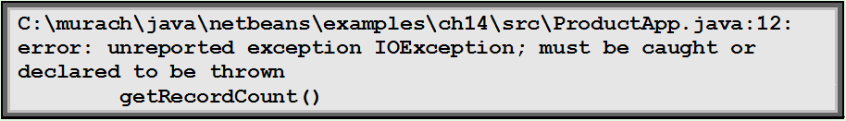
How Java Propagates Exceptions
Two ways to handle checked exceptions:
Throw the exception to the calling method
Catch the exception and handle it
Compiler ensures all involved methods handle (with try/catch) or "punt" with throws statement in method header.
Sample of the compiler error if you do not deal with checked exceptions

Slide 33
The effect of an exception
Effects on method that throws exception:
The throwing method finishes prematurely
At the point when exception is thrown
No return value is returned.
Effects on the method that receives an exception
Control does not return to the client’s point of call
So the client cannot carry on regardless
Program execution depends on whether the client catches and processes an exception
A client may ‘catch’ an exception

Slide 34
The throws clause
Methods throwing a checked exception must include a throws clause:
public void saveToFile(String destinationFile) throws IOException
Notice that required keyword throws used in declaration is different from keyword throw used in throw statement
Method may throw unchecked exceptions but compiler does not require that

Slide 35
IOException covers itself and its child class FileNotFoundException.
This method catches the IOException.
This method throw the IOException for someone else to catch

Slide 36
Exception handling
Checked exceptions extend class Exception but not class RuntimeException
Principles of exception throwing applies to both checked and unchecked exceptions
Principles of exception handling is requirement for checked exceptions only
Checked exceptions are meant to be caught
The compiler ensures that checked exception use is tightly controlled in both server and client
However, of course you should also do exception handling for unchecked exceptions like NullPointerException
Used properly, failures may be recoverable.

Slide 37
Other Examples

Slide 38
Example One: Preventing object creation
public ContactDetails(String name, String phone, String address)
{
if (name == null) {
name = "";
}
if (phone == null) {
phone = "";
}
if (address == null) {
address = "";
}
this.name = name.trim();
this.phone = phone.trim();
this.address = address.trim();
if (this.name.length() == 0 && this.phone.length() == 0) {
throw new IllegalStateException(
"Either the name or phone must not be blank.");
}
}

Slide 39
Example Two: Parameter Checking

Slide 40
Example Three: Forcing an Exception to Test Exception Handling

Slide 41
Example Four: Rethrowing an Exception
The purpose here is just to log a message before propagating upwards.
The exception is caught in the method where it occurs and that method's name is recorded. Then it is rethrown so that the calling function can handle it normally. Helps with tracing where exactly the error took place.

Slide 42
Exception Chaining
If you throw your own exception in response to another exception that has occurred, you only have information about the latest exception thrown.
How can you retain information from the original exception?
Instead of creating your custom exception with the Throwable() or Throwable(message) constructors, use constructors to capture the underlying cause.

Slide 43
Example of Exception Chaining (1)
When the new exception object is created, it is built with knowledge of e the exception that triggered it, that is "e".

Slide 44
Example of Exception Chaining (2)

Slide 45
Catching Errors

Slide 46
The try statement
The client that issues a call to the method which throws checked exception must add provisions for dealing with that exception
Clients catching an exception must protect the call with a try-catch statement:
try { Protect one or more statements here. } catch(Exception e) { Report and recover from the exception here. }
Note that catch block contains an exceptions object which may provide additional details about the error

Slide 47
Try…Catch Syntax

Slide 48
Try / Catch Example
public static String readFirstLine(String path)
{
RandomAccessFile in = null;
try {
in = new RandomAccessFile(path, "r"); // may throw FileNotFound
String line = in.readLine(); // may throw IOException
return line;
}
catch (FileNotFoundException e) {
System.out.println("File not found.");
return null;
}
catch(IOException e) {
System.out.println("I/O error occurred.");
return null;
}
finally {
try {
if (in != null) in.close(); // may throw IOException
}
catch (Exception e) {
System.out.println("Unable to close file.");
}
}
}

Slide 49
How the try statement works
1. Exception thrown from here
try {
addressbook.saveToFile(filename);
tryAgain = false;
}
catch(IOException e) {
System.out.println("Unable to save to " + filename);
tryAgain = true;
}
2. Control transfers to here
Note: If exception is thrown by saveToFile method then
Statement tryAgain = false is not executed
Control is transferred to catch block
Afterwards, execution is continued after the try-catch block

Slide 50
Catching multiple exceptions
try {
...
ref.process();
...
}
catch(EOFException e) {
// Take action on an // end-of-file exception.
...
}
catch(FileNotFoundException e) {
// Take action on a // file-not-found exception.
...
}
catch(Exception e) {
// "Exception" is the most general form of an exception
// This block will catch every exception that makes it this far.
...
}
Method may throw multiple exceptions
throws clause lists exceptions separated by coma
The exception is not thrown directly by the statement in the try block
The exception arises indirectly, passed back from the methods called in the try block.

Slide 51
The finally clause
try {
// Protect one or more statements here.
}
catch(Exception e) {
// Report and recover from the exception here.
}
finally {
// Perform any actions here whether or not an exception is thrown.
}
A finally clause is optional
A finally clause is executed even if a return statement is executed in the try or catch clauses.
An uncaught or propagated exception still exits via the finally clause
Possible to have try clause with no catch blocks but with finally clause -- The exception is thrown out of the block, just as in any other case where it's not caught.

Slide 52
Defining new exceptions
May need to create custom exceptions for more accurate description of the problem
Extend RuntimeException for an unchecked exceptions
Extend Exception for a checked exception.
Define new types to give better diagnostic information.
Include reporting and/or recovery information.
If you extend Exception then it is "checked", i.e if you throw it, it must be caught or declared in the method signature.
Unchecked exceptions extend RuntimeException and do not need to be declared or caught.

Slide 53
Defining new exceptions
public class NoMatchingDetailsException extends Exception
{
private String key; // An instance variable unique to subclass
public NoMatchingDetailsException(String key)
{
this.key = key;
}
public String getKey()
{
return key;
}
public String toString()
{
return "No details matching '" + key + "' were found.";
}
}

Slide 54
Methods of the Exception Class

Slide 55
Assertions

Slide 56
Assertions
Assertions were covered in Chapter 7 of Objects First with Java when you learned about JUnit and unit testing.
Used for internal consistency checks.
E.g. object state following mutation.
Used during development and normally removed in production version.
E.g. via a compile-time option.
Java has an assert statement
Statement of a fact that should be true in normal program execution
A Java compiler will include assert statements in the compiled code only if requested to do so.

Slide 57
Assert Statement
Thus, an assert statement serves two purposes.
It expresses explicitly what we assume to be true at a given point in the execution and therefore increases readability both for the current developer and for a future maintenance programmer
It actually performs the check at runtime so that we get notified if our assumption turns out to be incorrect. This can greatly help in finding errors early and easily.
public void removeDetails(String key) { if (key == null) { throw new IllegalArgumentException ("Null key passed to removeDetails.");
}
if (keyInUse(key)) { ContactDetails details = book.get(key);
book.remove(details.getName());
book.remove(details.getPhone());
numberOfEntries--;
}
// If remove() worked, key shouldn't be in use
assert ! keyInUse(key);
/* If false, the string will be passed to the
AssertionError object */
assert consistentSize() : "Inconsistent book size in removeDetails";
// See next slide for consistentSize() }

Slide 58
consistentSize()
/** * Check that the numberOfEntries field is consistent with * the number of entries actually stored in the address book. * @return true if the field is consistent, false otherwise. */ private boolean consistentSize() { Collection<ContactDetails> allEntries = book.values(); // Eliminate duplicates as we are using multiple keys. Set<ContactDetails> uniqueEntries = new HashSet<ContactDetails>(allEntries); int actualCount = uniqueEntries.size(); return numberOfEntries == this.actualCount; }
Although generally, why would we have an instance variable for numberOfEntries when we can return the result from size()?
Just gives us a place for inconsistencies!

Slide 59
Java Assertion Statement
Two forms available:
assert boolean-expression
assert boolean-expression : expression
The boolean-expression expresses something that should be true at this point
First form:
If true then nothing happens
If false then an AssertionError is thrown
Second form:
Passes an argument to AssertionError to better diagnose the problem
The argument will be converted to string when the AssertionError constructor is called

Slide 60
Guidelines for Assertions
Assertions are primarily intended to provide a way to perform consistency checks during the development and testing phases of a project.
They are not intended to be used in released code.
They are not an alternative to throwing exceptions
Use for internal checks during the development and project testing
Remove from the final production code
Don’t include normal functionality:
// Incorrect use: Combining normal call to remove() // with the assert statement assert book.remove(name) != null;

Slide 61

Assertions can generate exceptions when not true
452-453

Slide 62
Error Recovery

Slide 63
Error recovery
Clients should take note of error notifications.
Check return values
Don’t ‘ignore’ exceptions
Include code to attempt recovery
Will often require a loop:
take corrective actions and try again

Slide 64
Attempting recovery
// Try to save the address book.
boolean successful = false;
int attempts = 0;
do {
try {
addressbook.saveToFile(filename);
successful = true;
}
catch (IOException e) {
System.out.println("Unable to save to " + filename);
attempts++;
if(attempts < MAX_ATTEMPTS) {
filename = an alternative file name;
}
}
} while (!successful && attempts < MAX_ATTEMPTS);
if (!successful) {
// Report the problem and give up;
}

Slide 65
Error avoidance
Clients can often use server query methods to avoid errors
More robust clients mean servers can be more trusting
Unchecked exceptions can be used
Simplifies client logic and shortens the code
May increase client-server coupling
Server may not assume that all clients will perform such checks
May result in code duplication in client and server methods

Slide 66
Client / Server Cooperation
// Add what should be a new set of details to the address book. if (contacts.keyInUse(details.getName()) { contacts.changeDetails(details.getName(), details); } else if (contacts.keyInUse(details.getPhone()) { contacts.changeDetails(details.getPhone(), details); } else { // Add the details . . . }
The client (GUI) calls the server object's (contact's) keyInUse() method.
While sometimes this might result in redundancy (i.e., double checking), it can make for more foolproof code.

Slide 67
Appendix

Slide 68
Preventing Errors

Slide 69
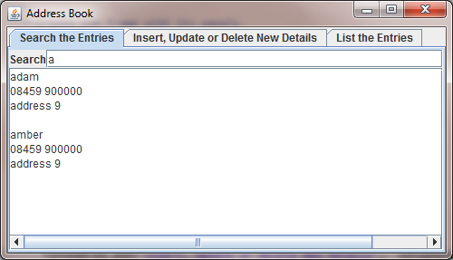
Exploring errors
Explore error situations through the address-book projects.
Use version on website
Two aspects:
Error reporting.
Error handling
By the way, an excellent GUI example of how to do a search!

Slide 70
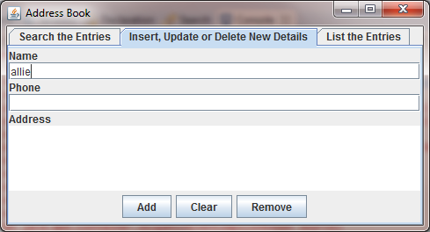
Exploring errors
Exception in thread "AWT-EventQueue-0" java.lang.NullPointerException
at addressBookGUI.AddressBook.removeDetails(AddressBook.java:123)
at addressBookGUI.AddressBookGUI$4.actionPerformed(AddressBookGUI.java:150)
at javax.swing.AbstractButton.fireActionPerformed(Unknown Source)
at javax.swing.AbstractButton$Handler.actionPerformed(Unknown Source)
at javax.swing.DefaultButtonModel.fireActionPerformed(Unknown Source)
at javax.swing.DefaultButtonModel.setPressed(Unknown Source)
at javax.swing.plaf.basic.BasicButtonListener.mouseReleased(Unknown Source)
at java.awt.Component.processMouseEvent(Unknown Source)
at javax.swing.JComponent.processMouseEvent(Unknown Source)
at java.awt.Component.processEvent(Unknown Source)
at java.awt.Container.processEvent(Unknown Source)
at java.awt.Component.dispatchEventImpl(Unknown Source)
at java.awt.Container.dispatchEventImpl(Unknown Source)
at java.awt.Component.dispatchEvent(Unknown Source)
at java.awt.LightweightDispatcher.retargetMouseEvent(Unknown Source)
at java.awt.LightweightDispatcher.processMouseEvent(Unknown Source)
at java.awt.LightweightDispatcher.dispatchEvent(Unknown Source)
...
Explore error situations through the address-book projects.
There is no "allie"

Slide 71
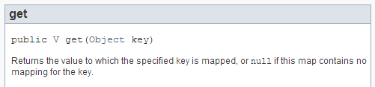
removeDetails() does not handle exceptions
details == null for "allie"
public void removeDetails(String key) {
ContactDetails details = book.get(key);
book.remove(details.getName());
book.remove(details.getPhone());
numberOfEntries--;
}
null pointer exception
TreeMap.get()

Slide 72
removeDetails() does not handle exceptions
details == null for "allie"
public void removeDetails(String key) {
ContactDetails details = book.get(key);
book.remove(details.getName());
book.remove(details.getPhone());
numberOfEntries--;
}
null pointer exception
A runtime error results
Whose ‘fault’ is this?
Anticipation and prevention are preferable to apportioning blame

Slide 73
removeDetails()
public void removeDetails(String key) {
ContactDetails details = book.get(key);
book.remove(details.getName());
book.remove(details.getPhone());
numberOfEntries--;
}
public void removeDetails(String key)
{
if (keyInUse(key)) {
ContactDetails details = book.get(key);
book.remove(details.getName());
book.remove(details.getPhone());
numberOfEntries--;
}
}
public boolean keyInUse(String key) {
return book.containsKey(key);
}

Slide 74
addDetails()
public void addDetails(
ContactDetails details)
{
book.put(details.getName(), details);
book.put(details.getPhone(), details);
numberOfEntries++;
}
public void addDetails(
ContactDetails details)
{
if (details != null) {
book.put(details.getName(), details);
book.put(details.getPhone(), details);
numberOfEntries++;
}
}

Slide 75
changeDetails()
public void changeDetails( String oldKey,
ContactDetails details)
{
removeDetails(oldKey);
addDetails(details); }
public void changeDetails( String oldKey,
ContactDetails details)
{
if (keyInUse(oldKey) && details != null) {
removeDetails(oldKey);
addDetails(details);
}
}
public boolean keyInUse(String key) {
return book.containsKey(key);
}

Slide 76
Server error reporting
How to report illegal arguments?
To the user?
Display an error message?
Is there a human user?
What if there is none?
Can they solve the problem?
Good for debugging but not for final code
Overly frequent error messages are more annoying than helpful

Slide 77
Tidbits

Slide 78

Multi-catch (Java 7)
437
try {
...
ref.process();
...
}
catch (EOFException | FileNotFoundException e) { // Take action appropriate to both exceptions. ... }
Introduced in Java 7
Use a single catch block for multiple exceptions
Exceptions must be at the same level in the Exception hierarchy.

Slide 79
Try with Resources
Prior to Java 1.7, you had to use a finally block to release system resources, which required additional exception handling code inside the finally block.
Try-with-resources statement simplifies this
Code a set of parentheses after the try keyword
Within the parentheses, code statements that declare and instantiate objects that use system resources
Only works with objects that implement java.lang.AutoClose interface. (covers most database classes and file classes)

Slide 80
Modifying the code to use try-with-resources
public static String readFirstLine(String path)
{
try (RandomAccessFile in =
new RandomAccessFile(path, "r"))
{
String line = in.readLine(); // may throw IOException
return line;
}
catch (FileNotFoundException e)
{
System.out.println("File not found.");
return null;
}
catch(IOException e)
{
System.out.println("I/O error occurred.");
return null;
}
}
No need for exception handling for file open and file close.

Slide 81
Error Output Stream
Using the System.err object, you can print data to the standard error output stream.
Often processors of the error output stream will format the error channel differently (e.g., in red text).
Having both the standard output stream and error output stream at your disposal is more flexible, e.g.:
Direct standard output stream to the console
Direct error output stream to a text file

Slide 82
Using the Error Output Stream
Resulting output for a FileNotFound Exception

Slide 83
How to print exception data to the standard output stream

Slide 84
Terms (1)
catch clause:
The part of a try statement responsible for handling a caught exception.
catching exceptions:
Exceptions are caught within the catch clause of a try statement. Catching an exception gives the program an opportunity to recover from the problem or attempt a repair for whatever caused it.
exception:
An object representing the occurrence of an exceptional circumstance - typically, something that has gone wrong in the smooth running of a program. Exception objects are created from classes that extend the Throwable class.
exception handler:
The try statement acts as an exception handler - a place where exception objects are caught and dealt with.

Slide 85
Terms (2)
checked exception:
An exception that must be caught locally in a try statement, or propagated via a throws clause defined in the method header.
unchecked exception:
An exception for which it is not required to provide a local try statement, or to propagate via a throws clause defined in the method header. An exception that is not handled will cause program termination if it is thrown.
propagation:
If an exception is thrown within a method, and there is no appropriate exception handler within the method, the exception may be propagated to the caller of the method. For a checked exception, the method must contain a throws clause in its header. A throws clause is not necessary for an unchecked exception to be propagated.
protected statement:
A statement within the try clause of a try statement.

Slide 86
Terms (3)
throw an exception
When an exceptional circumstance arises in a program - often as a result of a logical error, and exception object is created and thrown. If the exception is not caught by an exception handler, the program will terminate with a runtime error.
throws clause
A clause in a method header indicating that one or more exceptions will be propagated from this method. For instance public int find(String s) throws NotFoundException
throw statement
A statement used to throw an exception. For instance throw new IndexOutOfBoundsException(i+" is too large.");

Slide 87
Terms (4)
try statement:
The try statement acts as an exception handler - a place where exception objects are caught and dealt with. In its most general form, it consists of a try clause, one or more catch clauses and a finally clause.
try {
statement;
...
}
catch (Exception e) {
statement;
...
}
finally {
statement;
...
}
Either of the catch clause and finally clause may be omitted, but not both.

